Slide 1
Lecture 7: Systems Life Cycle
Neelima Satyam
IIIT, Hyderabad

Slide 2
System Life cycle
Throughout the system lifecycle, another systems engineering role is to achieve the optimum fit, balance, and compromise for the system.
And all the while, don’t forget your goal is to provide the customer with a system that satisfies his stated need.

Slide 3
Systems Engineers Perform a Balancing Act
To determine fit
Emphasize the whole, understand the pieces
Systematic, structured approach through applying quantitative, measurable terms
To achieve balance
Cost/risk/schedule against function/performance
Strive for reasonable expectations
To select the best compromise
Optimized system design is not necessarily technically superior
Design complexity versus development simplicity

Slide 4
The Systems Engineering Approach Seeks to Manage Multidisciplinary Factors
Function
System requirements
Performance specs
Human need
Complexity
New technology
Top-down plan
Conservative design
Continuous evolution
Minimal interfacing
Process characterization
Avoid complexity
Low level decisions
Specialized manufacturing
Performance
Flexible manufacturing
Strict process control
Manage complexity
Process revolution
Tight integration
Product stability
Risk of overdesign
Bottom-up implementation
Existing technology
Simplicity
Affordability
Strict acceptance criteria
Environmental imperatives
Form
Fit
Balance
Compromise
Cost and Schedule
Systems Architecting, Rechtin, Eberhardt, Prentice-Hall, Inc., 1991.

Slide 5
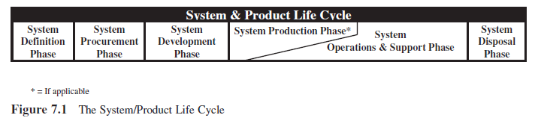
The system life cycle serves structurally as the foundation for system development. Human-made systems are conceptualized, planned, organized, scheduled, estimated, procured, deployed, operated and supported, and disposed of using this structure.

Slide 6
The System Definition Phase
The System Definition Phase begins with recognition by the User that a new system or upgrade to an existing system, product, or service is required to satisfy an operational need. The operational need may be derived from: 1) mission opportunities, 2) threats, or 3) projected system capability and performance “gaps” or deficiencies.

Slide 7
The System Procurement Phase
The System Procurement Phase consists of those activities required to procure the new system or
upgrades to the existing system. These activities include:
1. Qualifying capable system, product, or service vendors.
2. Soliciting proposals from qualified vendor.
3. Selecting a preferred vendor.
4. Contracting with the vendor to develop the system, product, or service.
The selected vendor becomes the System Developer or Services Provider.

Slide 8
The System Development Phase
The System Development Phase consists of those activities required to translate the contract system specifications into a physical system solution.
1. System Engineering Design
2. Component Procurement and Development
3. System Integration, Test, and Evaluation (SITE)
4. Authenticate System Baselines
5. Operational Test and Evaluation (OT&E).

Slide 9
The System Production Phase
The System Production Phase consists of those activities required to produce small to large quantities of the system. The initial production typically consists of a Low-Rate Initial Production (LRIP) to verify and validate that:
1. Production documentation and manufacturing processes are mature.
2. Latent defects such as design errors, design flaws, or poor workmanship are eliminated.
When the production process has been verified and validated based on field tests of system production samples, large-scale production, if applicable, may be initiated. Since the system and production engineering designs have already been verified, each production system is:
1. Inspected.
2. Verified against key System Performance Specification requirements.
3. Deployed to the User’s designated field site(s) for implementation (i.e., operations and support).

Slide 10
More systematic way of development
Better control of System Development incl. management of risk, changes, configuration
Traceability at all levels
Operational & supportability aspects
Effectiveness Analysis
Risk management
Operational - Maintainability, Availability, Safety etc
Ensures FINAL PRODUCT Fully Meets All User Requirements

Slide 11
Emphasis in SE
More complete definition of needs
Complete definition of needs facilitates verification of system performance
Minimize surprises at later stages
Life cycle engineering approach
Initial approach was Design cycle
Later with Design for Manufacture (DFM) approach Manufacturing cycle also included
Present thinking is to consider three life cycles i.e. Design, Manufacturing and Supportability concurrently
Leading to Concurrent Engineering (CE)

Slide 12
Life-cycle engineering approach
Development phase
Utilization phase
Conceptual & Preliminary Design
Detail Design & Development
Production and/or Construction
NEED
Product use Phase out and Disposal
Design
Manufacturing Configuration Design
Manufacture
Manufacturing Operations
Product support configuration design and development
Deployment
Product support and maintenance

Slide 13
Product life cycle
Identification of need
Research Input
Conceptual design
System concept
Preliminary Design
Subsystem design
Detailed Design & Development
Component design
Production/Construction
Development phasing
Utilization & Support
Phase-out and Disposal

Slide 14
The Waterfall Process Model
Requirements
Analysis
Easy/cheap to make changes
Specifications
Design
Hard/expensive to make changes
Implementation
Feedback
Test
Maintenance

Slide 15
The “V” Life-Cycle Model

Slide 16
Systems Engineering process
Basic steps
Define system objectives (user’s needs)
Establish performance requirements (requirements analysis)
Establish functionality (functional analysis)
Evolve design and operation concepts (design synthesis)
Select a baseline (thro’ trade-off studies)
Verify the baseline meets requirements
Iterate the process through lower level trades (decomposition)

Slide 17
INPUT
Requirements analysis
Functional analysis
Design Synthesis
System Analysis & Control
OUTPUT
Concept studies
System studies
Prelim. Design
Detailed Design

Slide 18
Conceptual design
Preliminary design
Detailed design & Development
Requirement analysis
Functional analysis
Design Synthesis
System analysis and control
Development phasing
Development
Production
Deployment
Operation
Support
Training
Verification
Disposal
System Engineering Management
System Engineering process
Life cycle approach
This interaction shows how to apply SE process to develop systems in life cycle approach

Slide 19
SE Management
Functional baseline
Allocated baseline (‘Design to’ specs.)
Product baseline (‘Build to’ specs.)
Drawing inputs from all the life cycle activities for various development phases
Development phasing
Baselines
Lifecycle planning
System Engineering Management
System Engineering process
Life cycle approach
Integrated approach
Integrated team from Systems engineering and discipline specialists

Slide 20
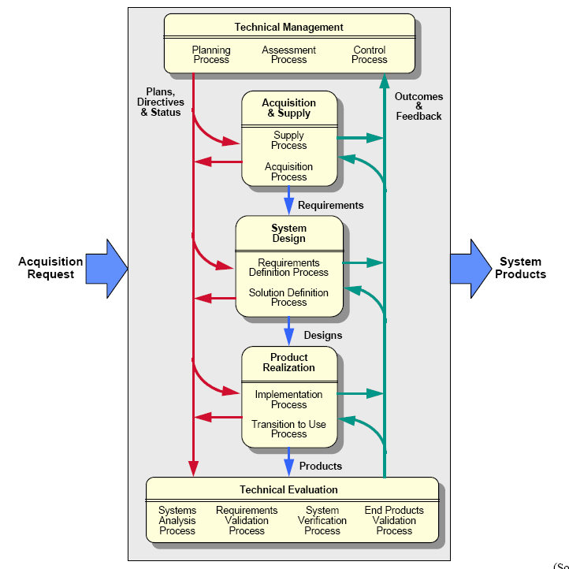
SE process overview

Slide 21
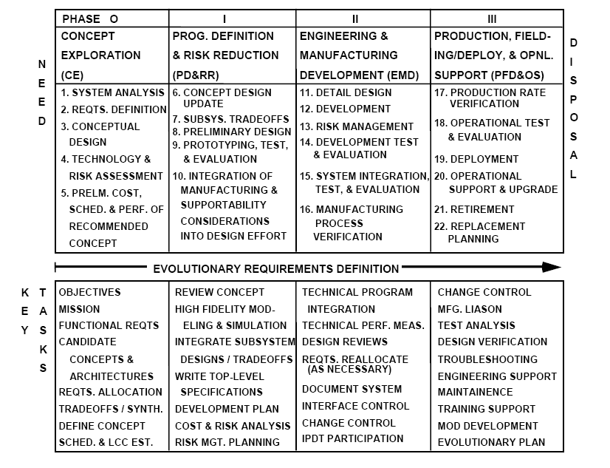
SE process mapped to Life cycle

Slide 22
Class Quiz (3)
Draw the Entity relationship diagram representing the logical and physical entities for any one of the following cases
Hostel Mess
Student Attendance system
You are tasked with Engineering a large System and have been asked to plan out the systems life cycle. List and explain all the phases/stages in the following system –
Introduction of metro rail transport in Hyderabad
Ensuring uninterrupted 24hrs water supply to a large city
Time: 20 mins

